Slide 1
Replacement of Dryer
①Conduct the automatic pump down.
②Quickly replace the dryer with new one
③Conduct vacuum-dehydrating from the quick joint located
at the inlet side of dryer.
④Conduct refrigerant leakage test
⑤Check on the green color of liquid / moisture indictor after system
operation started.
⑥Adhere an anti-corrosion tape on the flare nut section.

Slide 2
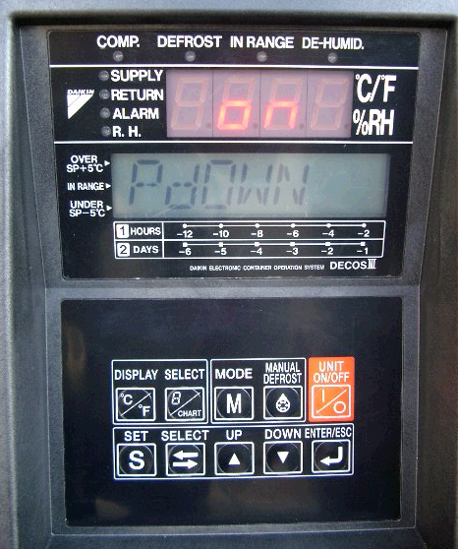
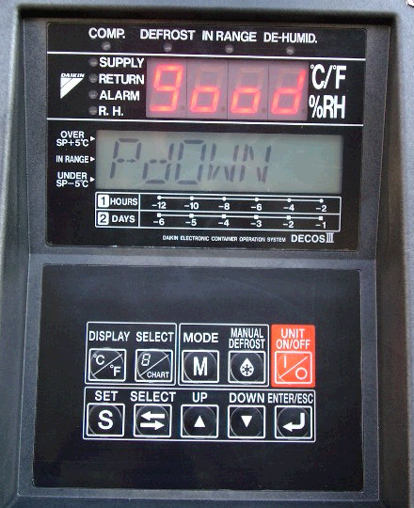
Replacement of Dryer
①Conduct the automatic pump down.
Pump down mode
Pump down completed
Press □ key
to start pump
down.
Press the M key twice to select the pump down mode,
then, the LCD indicates “PdOWN”.
Select “on” by using △ key or ▽ key.

Slide 3
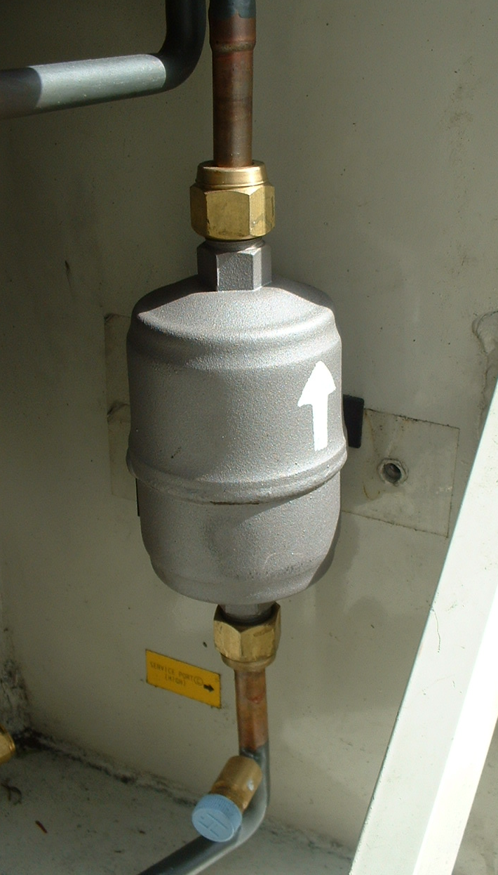
Replacement of Dryer
② Quickly replace the dryer
with new one.
Quickly replace the dryer with new one
after loosen the flare nuts on the inlet
and outlet side of the dryer.
Loosen the flare nuts

Slide 4
Replacement of Dryer
③Conduct vacuum-dehydrating
from the quick joint located
at the inlet side of dryer.
④Conduct refrigerant leakage test
After completion of the replacement
of dryer, be sure to conduct refrigerant
Leakage test to confirm that no
Refrigerant leakage is existing.
When the flare nuts are loosened,
if no leakage sound of gas refrigerant
could be detected at the flare nut
section, an air mixing into the
refrigerant is suspected.
In this case, conduct vacuum-dehydrating
from the quick joint located at the inlet
side of dryer.
Conduct refrigerant
Leakage test.
Quick joint
(for vacuum- dehydrating)

Slide 5
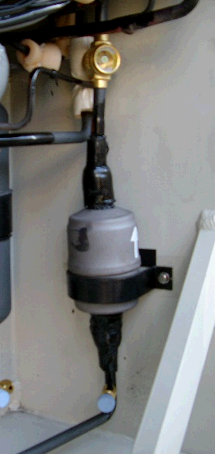
Replacement of Dryer
⑤Check on the green color of
liquid / moisture indictor after
system operation started
⑥Adhere an anti-corrosion tape
on the flare nut section.
Moisture indicator
Color | Judgment
Green | Dry
Yellow | Wet (moisture entered)
Anti-corrosion tape

